Slide 1
Heaps
Pro Academy I
Data Structure
Notes:
By leonardi.l

Slide 2
Definition
Heaps (Binary Heap) is a special Binary Tree
It's a Complete Tree, all level are completely filled to its leftmost position
Thus makes the Heap suitable to be stored in an Array
Binary Heap is either Min Heap or Max Heap
Min Binary Heap :
The key at the root must be minimum among all keys present under it.
The same property must be recursively true for all nodes inside the Binary Tree.

Slide 3
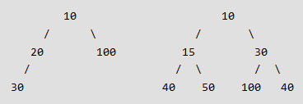
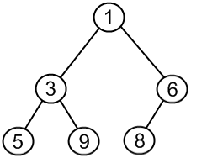

Heaps
Complete Binary Tree
Min Heap
Max Heap

Slide 4
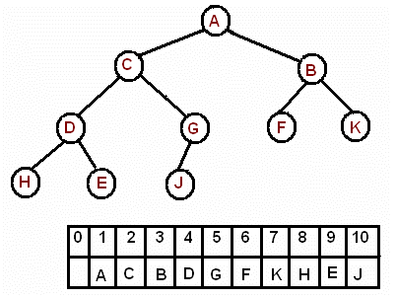
Heap Array Implementation
its left child is located at 2*k index
its right child is located at 2*k+1. index
its parent is located at k/2 index

Slide 5
Operations (Min Heap)
getMin(): It returns the root element of Min Heap
extractMin(): Removes the minimum element from Min Heap – then do heapfy()
decreaseKey(): Decreases value of key
insert(): Inserting a new key
delete(): Deleting a key
Notes:
* getMini(): It returns the root element of Min Heap. Time Complexity of this operation is O(1).
* extractMin(): Removes the minimum element from Min Heap. Time Complexity of this Operation is O(Logn) as this operation needs to maintain the heap property (by calling heapify()) after removing root.
* decreaseKey(): Decreases value of key. Time complexity of this operation is O(Logn). If the decreases key value of a node is greater than parent of the node, then we don’t need to do anything. Otherwise, we need to traverse up to fix the violated heap property.
* insert(): Inserting a new key takes O(Logn) time. We add a new key at the end of the tree. IF new key is greater than its parent, then we don’t need to do anything. Otherwise, we need to traverse up to fix the violated heap property.
* delete(): Deleting a key also takes O(Logn) time. We replace the key to be deleted with minum infinite by calling decreaseKey(). After decreaseKey(), the minus infinite value must reach root, so we call extractMin() to remove key.

Slide 6
Binary Heaps: Array Implementation
Implementing binary heaps.
Use an array: no need for explicit parent or child pointers.
Parent(i) = ⎣i/2⎦
Left(i) = 2i
Right(i) = 2i + 1
Root = 1 (or in other implementation : 0)
06
1
14
45
2
3
78
18
47
53
4
5
6
7
83
91
81
77
84
99
64
8
9
10
11
12
13
14
Notes:
parent and children formula require only simple bit twiddling operations

Slide 7
Binary Heap: Insertion
Insert element x into heap.
Insert into next available slot.
Bubble up until it's heap ordered.
Peter principle: nodes rise to level of incompetence
06
14
45
78
18
47
53
83
91
81
77
84
99
64
42
next free slot

Slide 8
Binary Heap: Insertion
Insert element x into heap.
Insert into next available slot.
Bubble up until it's heap ordered.
Peter principle: nodes rise to level of incompetence
06
swap with parent
14
45
78
18
47
53
83
91
81
77
84
99
64
42
42

Slide 9
Binary Heap: Insertion
Insert element x into heap.
Insert into next available slot.
Bubble up until it's heap ordered.
Peter principle: nodes rise to level of incompetence
06
swap with parent
14
45
78
18
47
42
83
91
81
77
84
99
64
42
53

Slide 10
Binary Heap: Insertion
Insert element x into heap.
Insert into next available slot.
Bubble up until it's heap ordered.
Peter principle: nodes rise to level of incompetence
O(log N) operations.
06
swap with parent
14
42
78
18
47
45
83
91
81
77
84
99
64
53

Slide 11
Binary Heap: Decrease Key
Decrease key of element x to k.
Bubble up until it's heap ordered.
O(log N) operations.
06
14
42
78
18
47
45
83
91
81
77
84
99
64
53

Slide 12
Binary Heap: Delete Min
Delete minimum element from heap.
Exchange root with rightmost leaf.
Bubble root down until it's heap ordered.
power struggle principle: better subordinate is promoted
06
14
42
78
18
47
45
83
91
81
77
84
99
64
53

Slide 13
Binary Heap: Delete Min
Delete minimum element from heap.
Exchange root with rightmost leaf.
Bubble root down until it's heap ordered.
power struggle principle: better subordinate is promoted
53
14
42
78
18
47
45
83
91
81
77
84
99
64
06

Slide 14
Binary Heap: Delete Min
Delete minimum element from heap.
Exchange root with rightmost leaf.
Bubble root down until it's heap ordered.
power struggle principle: better subordinate is promoted
53
exchange with left child
14
42
78
18
47
45
83
91
81
77
84
99
64

Slide 15
Binary Heap: Delete Min
Delete minimum element from heap.
Exchange root with rightmost leaf.
Bubble root down until it's heap ordered.
power struggle principle: better subordinate is promoted
14
exchange with left child
53
42
78
18
47
45
83
91
81
77
84
99
64

Slide 16
Binary Heap: Delete Min
Delete minimum element from heap.
Exchange root with rightmost leaf.
Bubble root down until it's heap ordered.
power struggle principle: better subordinate is promoted
O(log N) operations.
14
exchange with left child
18
42
78
53
47
45
83
91
81
77
84
99
64

Slide 17
Speed
Algorithm | Speed
getMini | O(1)
extractMini | O(log n)
decreaseKey | O(log n)
insert | O(log n)
delete | O(log n)

Slide 18
Binary Heap: Heapsort
Heapsort.
Insert N items into binary heap.
Perform N delete-min operations.
O(N log N) sort.
No extra storage.

Slide 19
Applications of Heap
Heap Sort
Priority Queue
Used in Graph Algorithms like Dijkstra’s Shortest Path and Prim’s Minimum Spanning Tree.
Many problems can be efficiently solved using Heaps. Ex :
K^{th} Largest Element in an array.
Sort an almost sorted array
Merge K Sorted Arrays.
Notes:
* Heap Sort: Heap Sort uses Binary Heap to sort an array in O(nLogn) time.
* Priority Queue: Priority queues can be efficiently implemented using Binary Heap because it supports insert(), delete() and extractmax(), decreaseKey() operations in O(logn) time. Binomoial Heap and Fibonacci Heap are variations of Binary Heap. These variations perform union also efficiently.
* Graph Algorithms: The priority queues are especially used in Graph Algorithms like Dijkstra’s Shortest Path and Prim’s Minimum Spanning Tree.
* Many problems can be efficiently solved using Heaps. See following for example.
a) K’th Largest Element in an array.
b) Sort an almost sorted array/
c) Merge K Sorted Arrays.

